Slide 1
The effect of morphology and localization of dopamine transporters on dopamine reuptake mechanism
Cihan Kaya

Slide 2
Introduction
Dopamine belongs to the family of catecholamines
Hormones Epinephrine and Norepinephrine (other catecholamines) are derived from Dopamine
Significant role in learning, goal-directed behavior, regulation of hormones, motor control

Slide 3
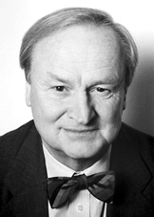
History
Synthesized by George Barger and James Ewens in 1910
Was considered as just a precursor to Epinephrine and Norepinephrine
Function as neurotransmitter discovered by Arvid Carlsson in 1958

Slide 4
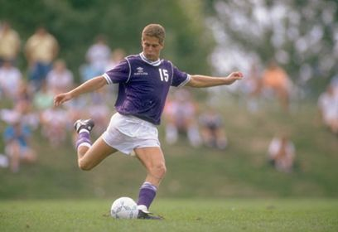
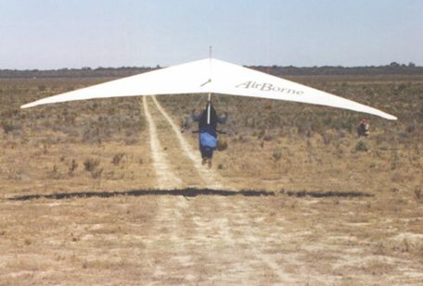
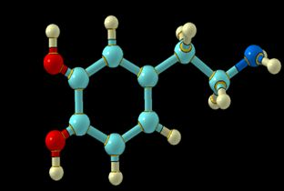
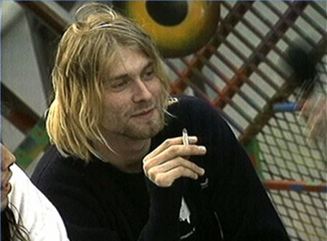
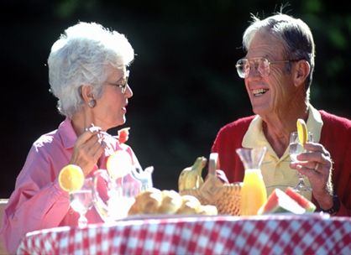
Movement
Motivation
Dopamine
Addiction
Reward & well-being
NIDA

Slide 5
NIDA

Slide 6
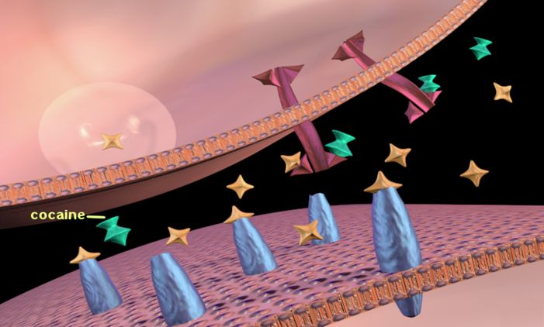
Notes:
But what happens when a person takes a drug? This slide shows how cocaine is able to alter activity in the synapse. Cocaine (shown in green), attaches to dopamine transporters (shown in purple), thereby blocking dopamine from being taken back up by the first neuron. Thus dopamine can continue to stimulate (maybe over-stimulate) the receptors of the second neuron because it remains in the synapse for a longer period of time. This duration of stimulation and amount of dopamine in the synapse is far greater than what normally occurs when a person engages in an enjoyable activity (e.g., eating, sex, etc), and is what produces cocaine’s intense euphoria and potential for abuse.

Slide 7
Previous Models
$$DAo+DAT⇌DA−DAT⇢DAi+DAT$$
$$\frac{d[DA]}{dt}=f∙\left[DA\right]p−\frac{Vmax}{\frac{Km}{[DA]}+1}$$
Missing quantal release mechanism
$$\frac{df}{dt}=−f(DA.D2)$$
$$\frac{df}{dt}=DF−k[DA]$$
No quantal release mechanism
Garris et. al., 1994
Viggiano et. al, 2004

Slide 8
Previous Model
Single parameter for spatial variables
Parameter | Name
α | Void fraction
λ | Tortuosity
k′ for DA | DA reuptake rate
U | Volume of a vesicle
C_{f} | Concentration of a vesicle
D (37 °C) | Dopamine diffusion constant
No mechanistic description
The concentration of dopamine increased mainly because of diffusion.
Single synapse model with single release.
Rice et. al., 2011.

Slide 9
Motivation
Spatial model
Quantal release and solve reaction-diffusion system for multisynaptic system
Investigate the effects of distribution and concentration of dopamine transporters
Investigate the effect of cocaine on extra-synaptic dopamine concentration

Slide 10
Difference between dopaminergic and glutamergic synapses
Parameter | Dopamine | Glutamate | refs.
Transporter localization | DA axons, somata and dendrites | Pre- and postsynaptic, surrounding glia | Nirenberg et al., 1996a Seal and Amara, 1999 Danbolt, 2001
Transporter cycle rate (molecules/s/transporter) | 2–5 | 35 | Wadiche et al., 1995 Povlock and Schenk, 1997 Prasad and Amara, 2001
Intersynaptic distance (forebrain) | 1.2–3.5 μm | 0.5 μm | Doucet et al., 1986 Pickel et al., 1981 Descarries et al., 1996 Cragg and Rice, 2004 Arbuthnott and Wickens, 2007
Receptor localization | extrasynaptic | intra- and extrasynaptic | Sesack et al., 1994 Yung et al., 1995 Hersch et al., 1995 Khan et al., 1998 Ottersen and Landsend, 1997 Galvan et al., 2006
Receptor sensitivity | nM-μM | μM-mM | Richfield et al., 1989 Neve and Neve, 1997
Receptor response time | 1–5 ms | 50 ms - >1 s | Rusakov and Kullman, 1998 Barbour, 2001
Rice et. al., 2011.

Slide 11
Model
Rice et. al., 2008.

Slide 12
Geometry Preparation
ssTEM stack from Drosophila ventral nerve cord (VNC) available on TrakEM2 software website.

Slide 13
Geometry Preparation
ssTEM stack from Drosophila ventral nerve cord (VNC) available on TrakEM2 software website.
Cardona et. al, 2010.

Slide 14
Geometry Preparation
TrakEM2 is an ImageJ plugin for image registration, segmentation and annotation.
Advantage : Provides wavefront file format which can be imported into Blender.

Slide 15
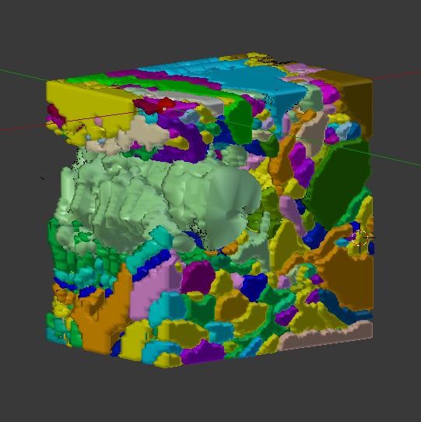
Geometry Preparation
The stack is already segmented and 3D reconstruction is prepared in TrakEM2.

Slide 16
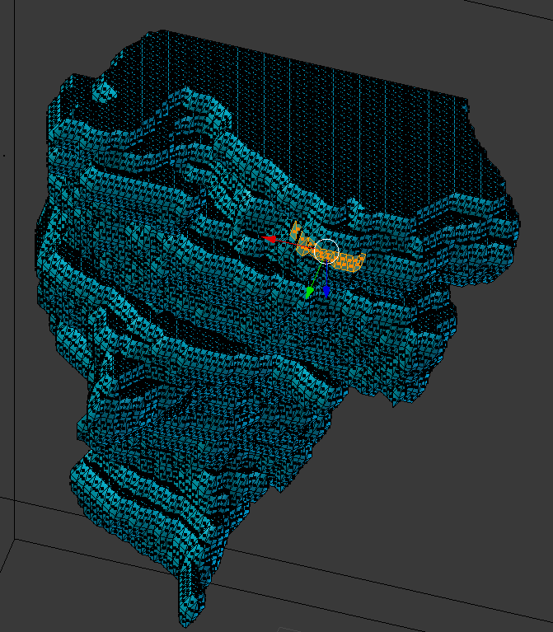
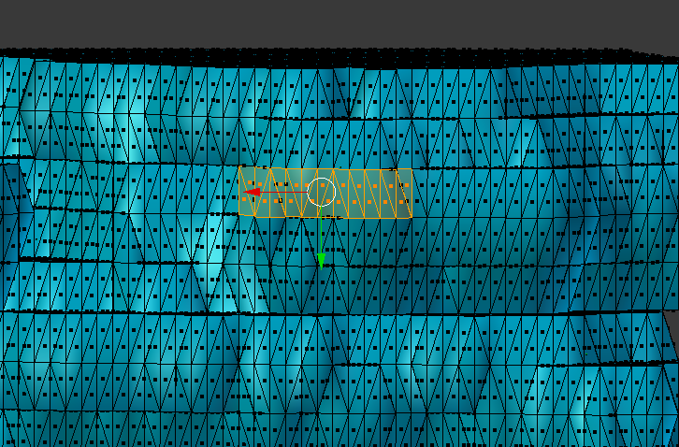
Geometry Preparation
3D reconstructed image is labeled in Blender.

Slide 17
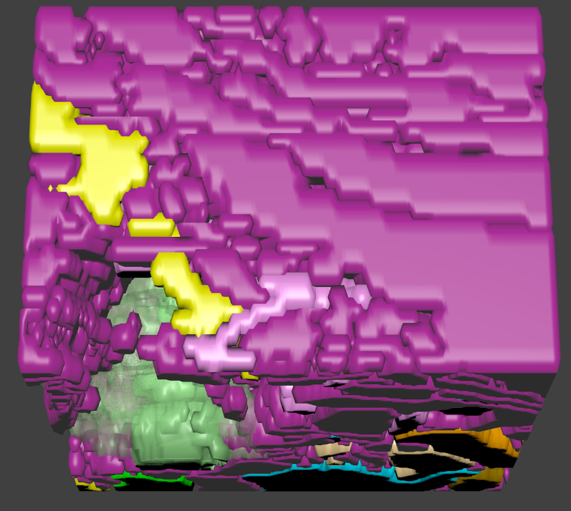
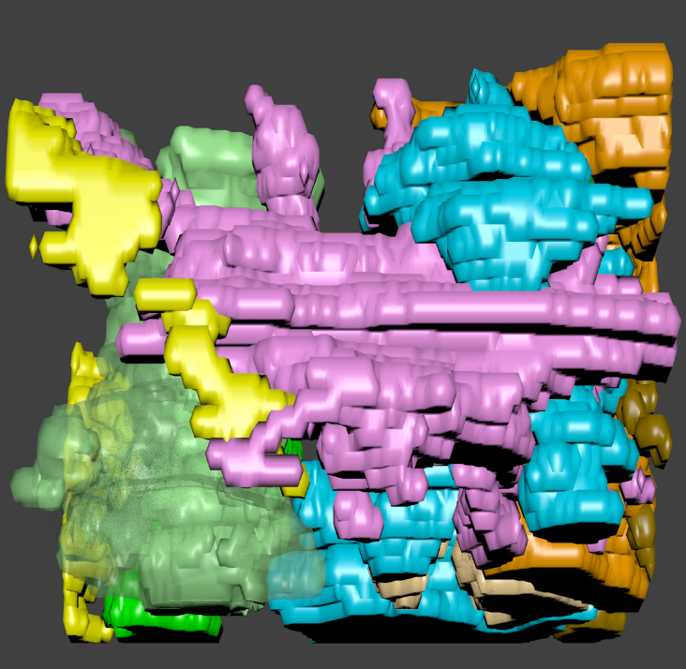
Geometry Preparation
Geometry has:
11 axons
24 synapses
89 transporter regions (randomly assigned around synaptic clefts)
Rest of the objects (dendrites, glial cells) used as single reflective surface

Slide 18
Reaction-Diffusion System
k₁
k_{cat}
$$DAo+DAT⇌DA−DAT⇢DAi+DAT$$
k₋₁
Parameter | Value | Ref
k₁ | 4e7 M⁻¹ s⁻¹ | Garris et. al.
k₋₁ | 0
k_{cat} | 7 s⁻¹ | Garris et. al.
D_{DA} | 7.38e-6 cm²/s | Rice et. al.
D_{DAT} | 0
Q | 9800 molecules | Rice et. al.

Slide 19
Reaction-Diffusion System

Slide 20
Reaction-Diffusion System
Diffusion around the boundaries has unrealistic profiles.

Slide 21
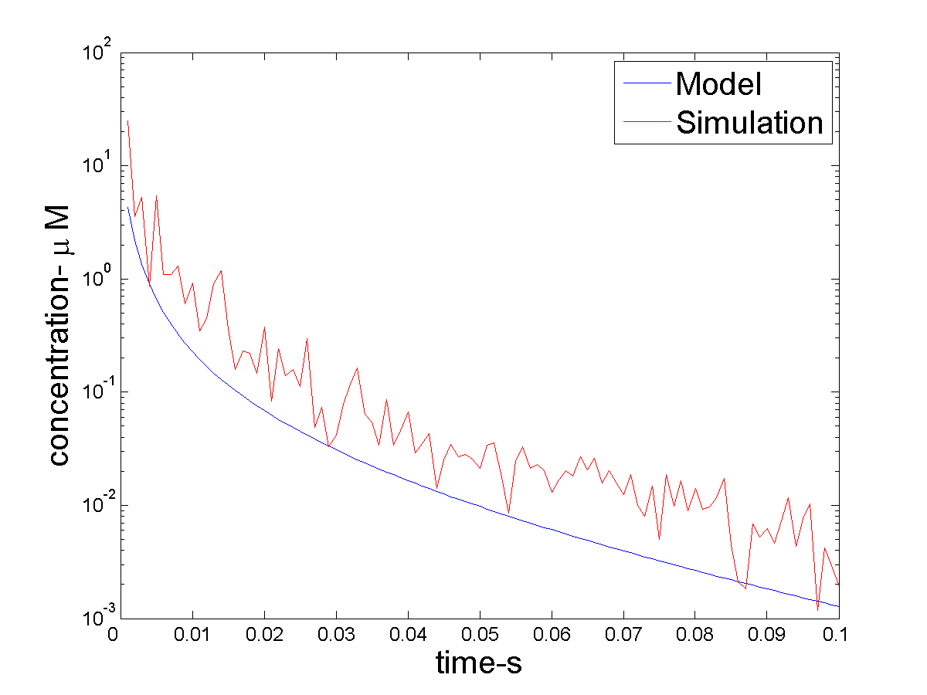
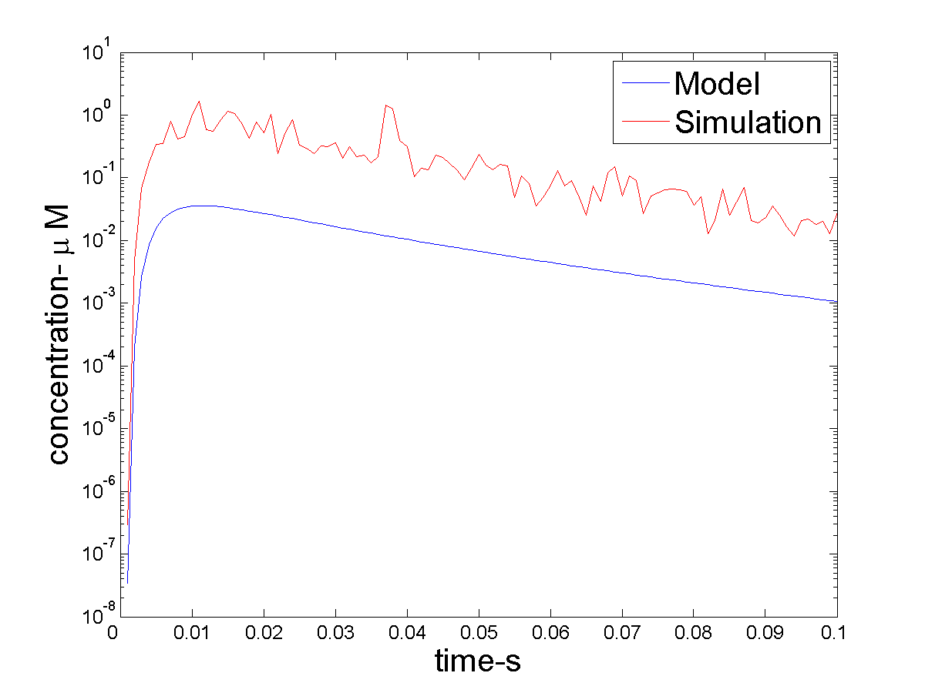
Reaction-Diffusion System
$$1 μm$$
$$5 μm$$
Similar results to volume transmission model and because of realistic diffusion, concentration gradient is smaller.
Rice et. al., 2004.

Slide 22
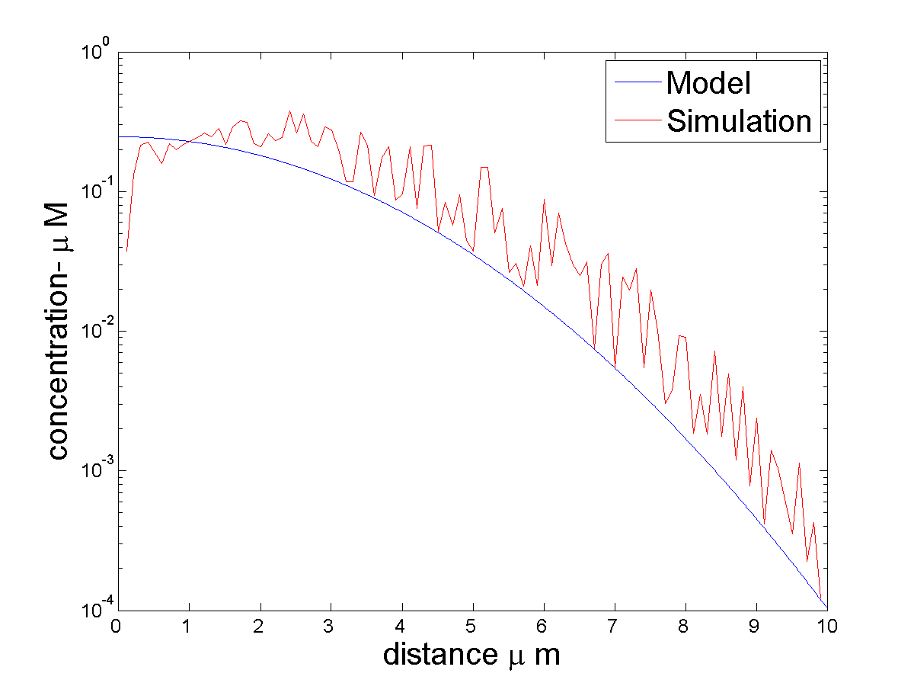
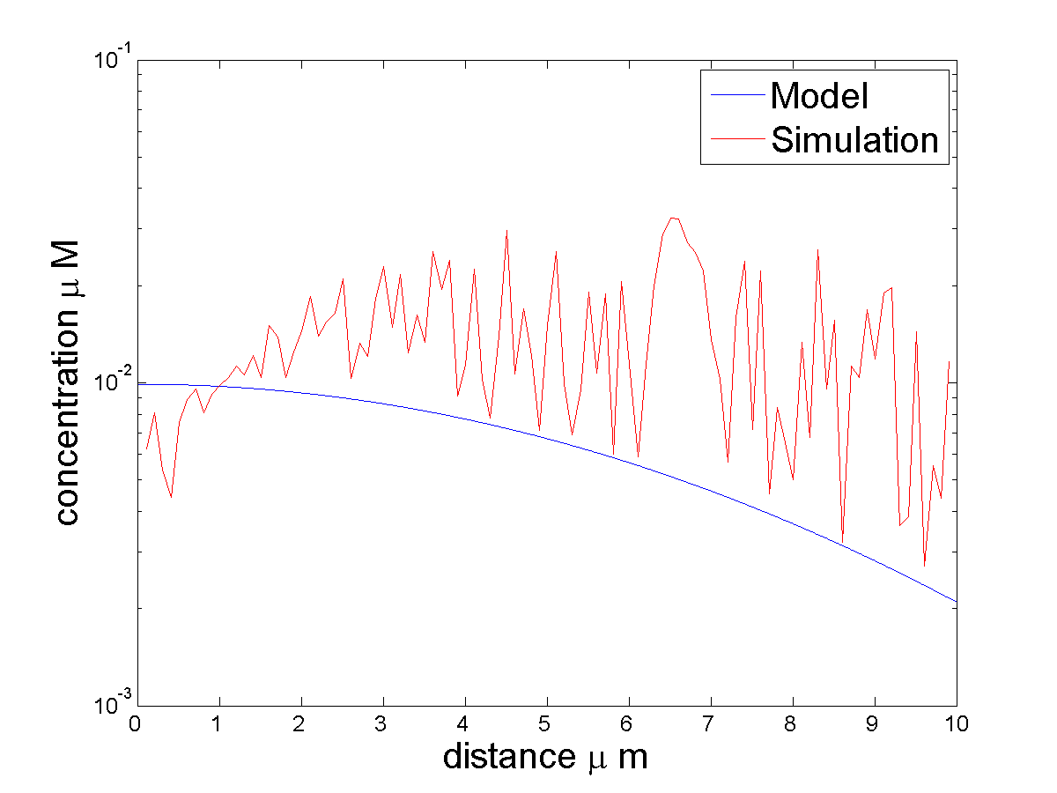
Reaction-Diffusion System
$$10 ms$$
$$50 ms$$
The transporters are only distributed around synaptic clefts and it may cause this reduced gradient.
Rice et. al., 2004.

Slide 23
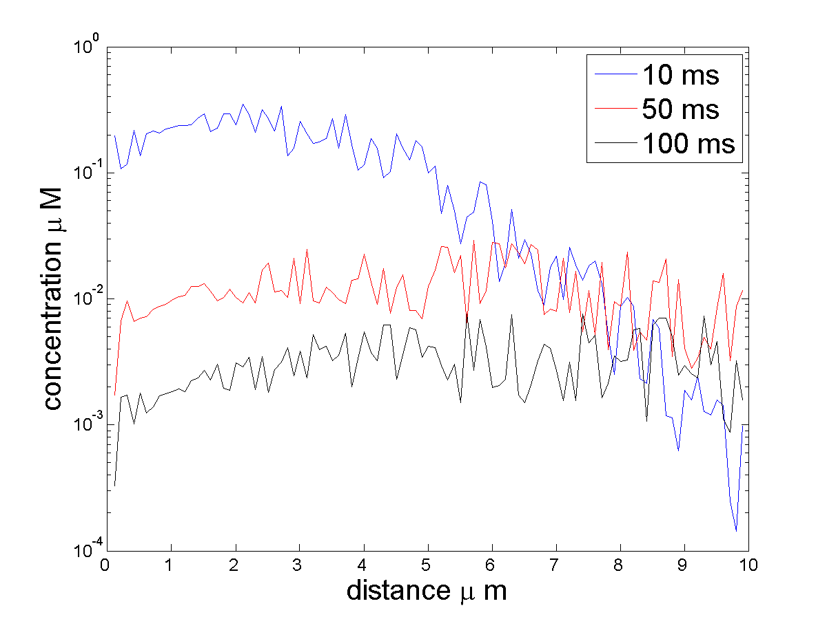
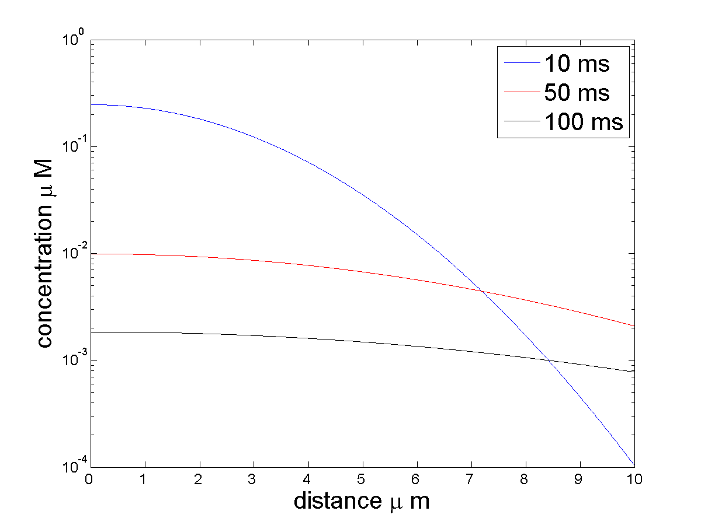
Reaction-Diffusion System
Model
$$Volume Transmission$$
Early in the simulation, results are similar in both models because the effect of diffusion is smaller.
Rice et. al., 2004.

Slide 24
Transporter Location
10x10 μm stacks with 0.4 μm separation.
Mouse striatum (HA-DAT strain) slices
Stained with anti-HA antibodies and Cy3 anti-mouse antibodies.
Red are dopamine transporters.
Sorkin Lab

Slide 25
Realistic Images
Axonal varicosities

Slide 26
Future Work
Implementation of realistic geometry
Effect of distribution and concentration of dopamine transporters on extra-synaptic dopamine concentration
D2 Receptors will be implemented in model and their contribution to quantal release.
Vesicle trafficking will be implemented with Ca metabolism.

Slide 27
Acknowledgements
Dr. Ivet Bahar
Dr. James Faeder
Dr. Alexander Sorkin
Dr. Ethan Block
Bahar Lab
Faeder Lab

