Slide 1
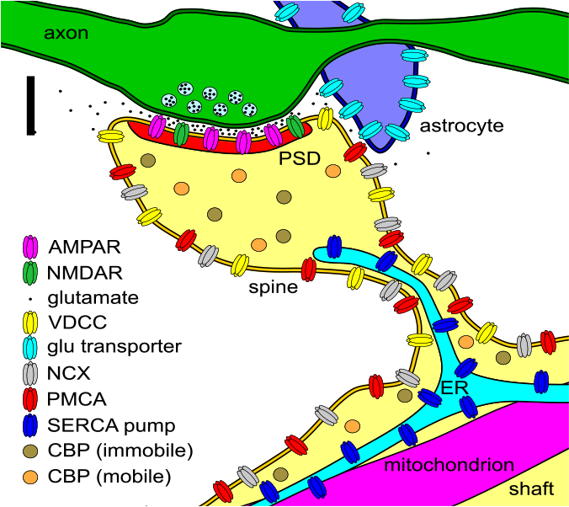
In silico reconstitution of spine calcium transients from individual proteins
Mary Kennedy, Dylan Bannon
Caltech
Tom Bartol, Terry Sejnowski, Dan Keller, Justin Kinney
Salk Institute
Kristen Harris, Chandrajit Bajaj
U. of Texas, Austin
Funded by CRCNS grant from N.I.D.A.
1

Slide 2
“Systems Biology”
Systems biology usually constitutes a cycle:
1. theory (quantitative modeling to propose specific testable hypotheses),
2. Experimental measurements,
3. use of the newly acquired data to refine the quantitative model or theory.

Slide 3
Purpose of a detailed molecular model
A model built from measurements on purified proteins is analogous to a “Reconstitution Experiment”, the biochemical gold standard for studies of molecular mechanisms of cellular processes.
The goal of a reconstitution experiment is to test whether the assembly of molecules postulated as the “mechanism” can account for a cellular behavior quantitatively.

Slide 4
The Team
Salk Institute
Tom Bartol
Dan Keller
Justin Kinney
Terry Sejnowski
Caltech
Melanie Stefan
Dylan Bannon
Stefan Mihalas
Shirley Pepke
Tamara Kinzer-Ursem
Leslie Schenker
Meera Reghunathan
Mary Kennedy
U. Texas Austin
Kristen Harris
Chandra Bajaj

Slide 5
MCell Models
1. Modeling in Arbitrary Geometries
2. Accurate Placement of proteins (in membrane, cytosol, and extracellular space)
3. Simulation of diffusional interactions and reactions with Stochastic Kinetics
4. Lays down Numerical and Visual Data

Slide 6
Control of the Ca²⁺ transient in the spine
Tom Bartol

Slide 7
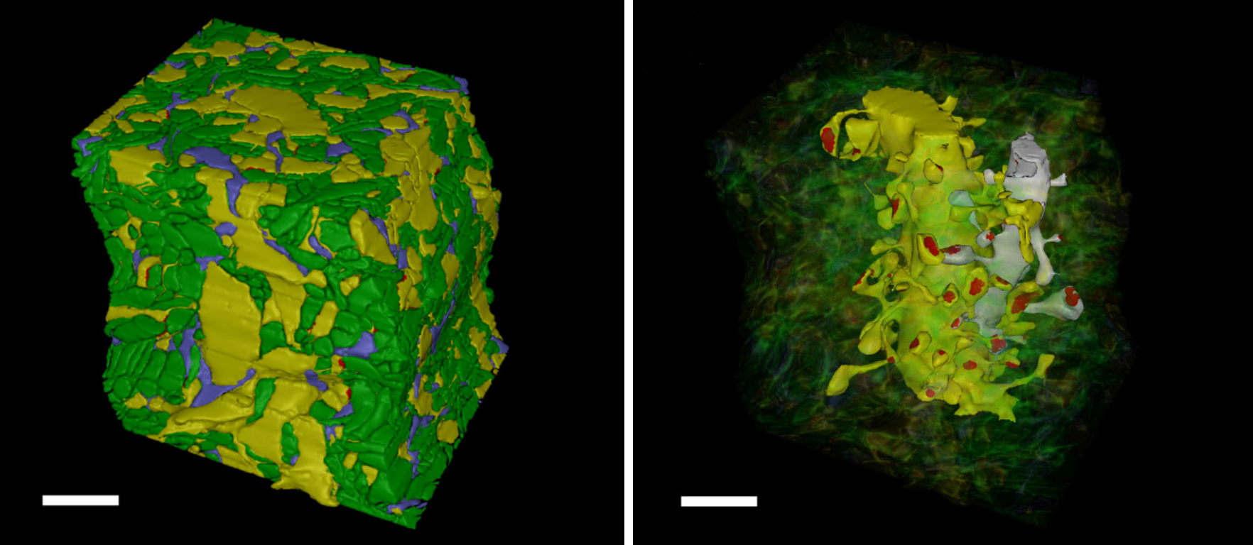
5 x 5 x 6 µm Reconstructed Neuropil
Kristen Harris, Justin Kinney, Chandra Bajaj

Slide 8
Model Building Work Flow
Collect parameters from biochemical literature
Make Q10 adjustments so that all parameters are valid at the temperature of the experiments
Write MCell files to:
1. assign all molecules
diffusion coefficients,
density on surfaces or concentration in spaces,
binding and enzymatic rates
2. place molecules within the geometry

Slide 9
Nine parameters were adjusted within experimental limits to fit experimental data.
Voltage-dependent Ca²⁺ Channels
density in spine membrane
density in shaft membrane
Immobile Ca²⁺ Binding Proteins
concentration in cytosol
kon
koff
Plasma Membrane Ca²⁺ ATPase pumps
density in spine membrane
density in shaft membrane
Na⁺/Ca⁺ Exchangers
density in spine membrane
density in shaft membrane
Ratio of Ca²⁺ ions pumped by PMCA’s and NCX’s: 1:1

Slide 10
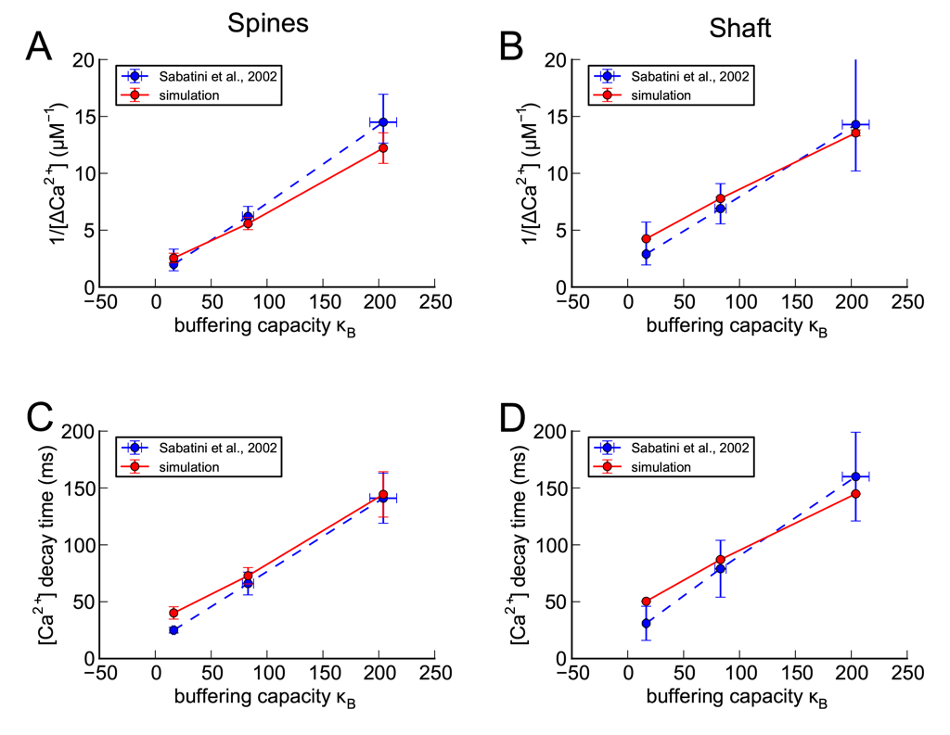
Fit (from 4 spines on smaller dendrite)

Slide 11
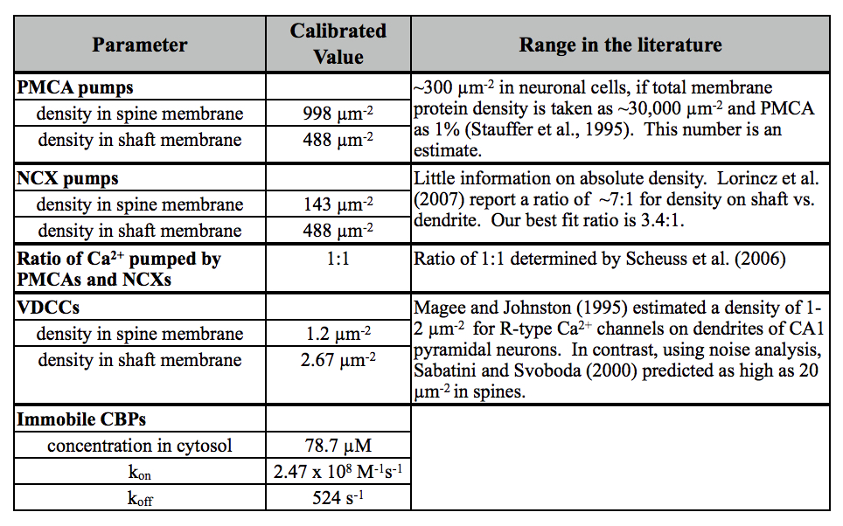
Calibrated parameters

Slide 12
The answer is YES
The assembly of molecules postulated to control Ca²⁺ in a synaptic spine during a bAP can be reconstituted in silico to give a first order quantitative account for Ca²⁺ transients measured in living neurons.

Slide 13
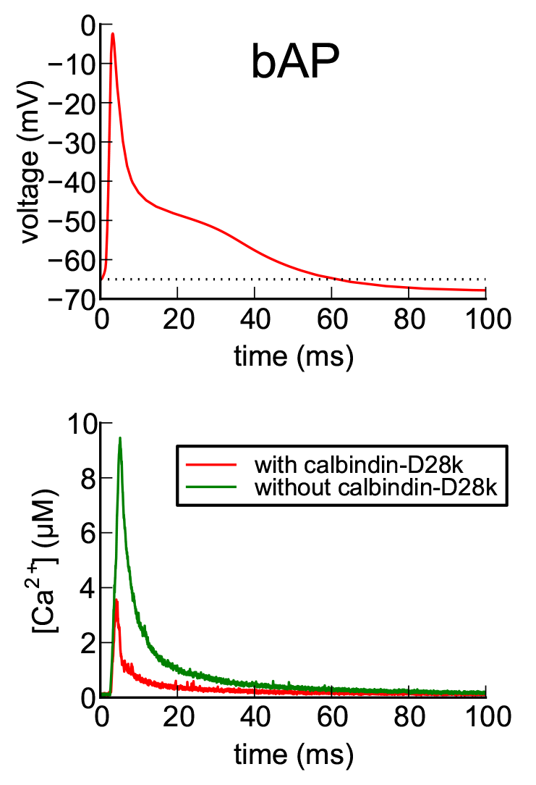
Stimulus
Ca²⁺ transient

Slide 14
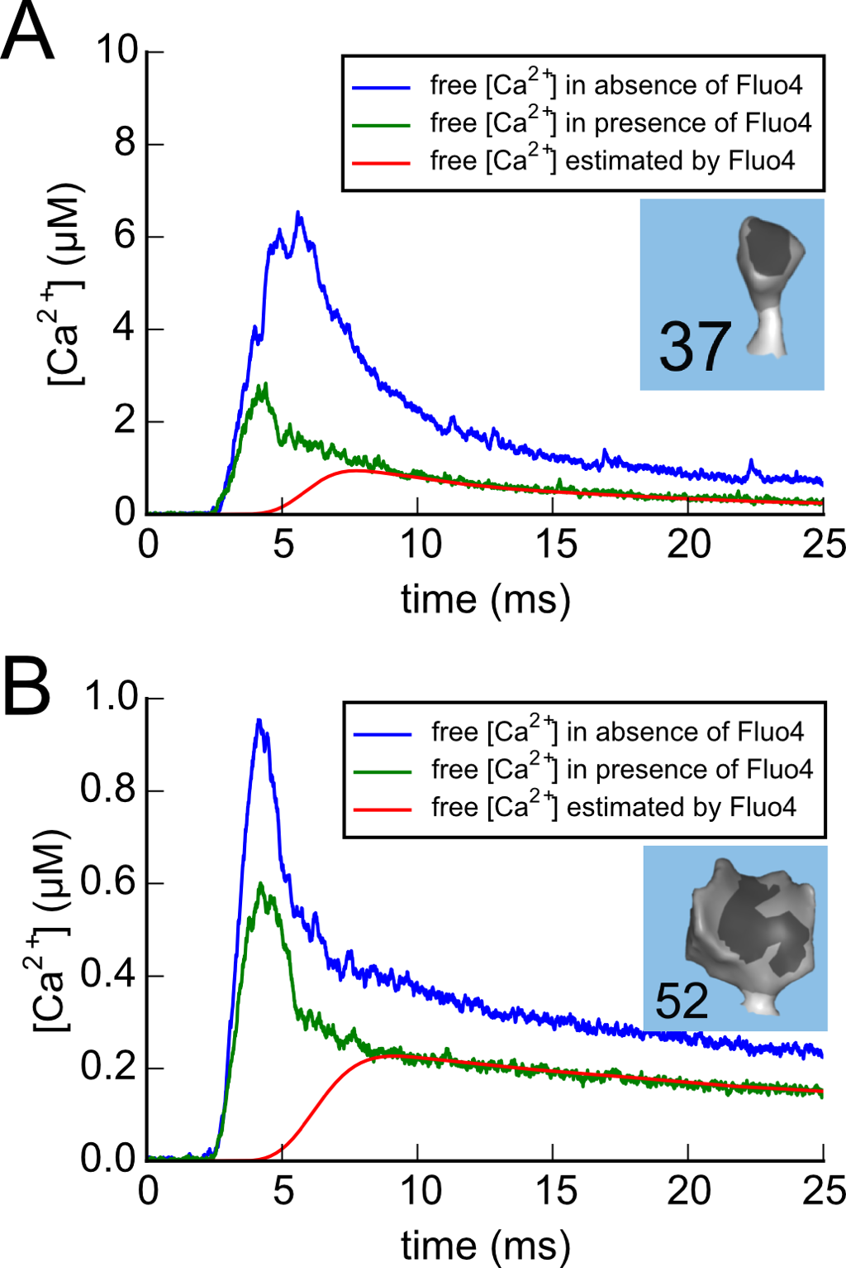
0.019 fl
0.2 fl

