Slide 1
CSP 6: Distance-Dependent
Structure and Function of
Neuronal Dendrites
Kristen Harris (CLM UT Austin)
Tom Bartol, Terry Sejnowski (CNL Salk)
Notes:
Spontaneous and Stochastic: not caused by electrical/synaptic activity
Transient: rise time of ~15 ms, duration of ~100 ms
Localized: maximal spatial extent of ~2 µm
Repetitive: repeat in the same location
Specialized: predominantly at dendritic branch points on main apical dendrite - also on finer branches and in the soma
Sizable: Amplitudes of 20-100 nM (10–70% of bAP)
Frequency modulation:
Subthreshold membrane potential changes
Repetitive synaptic stimulation at moderate frequencies
Intracellular: release of calcium from SER into cytoplasm
Resemble calcium ‘sparks’ and ‘puffs’ in cardiac myocytes. There sparks represent activity of the molecular machinery responsible for coupling plasma membrane depolarization to release of Ca²⁺ from a form of smooth endoplasmic reticulum (SER) known as the sarcoplasmic reticulum (SR) to elicit contraction of the muscle.

Slide 2
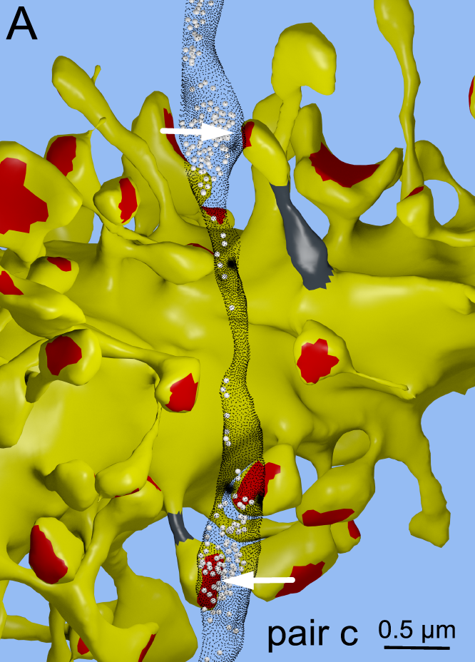
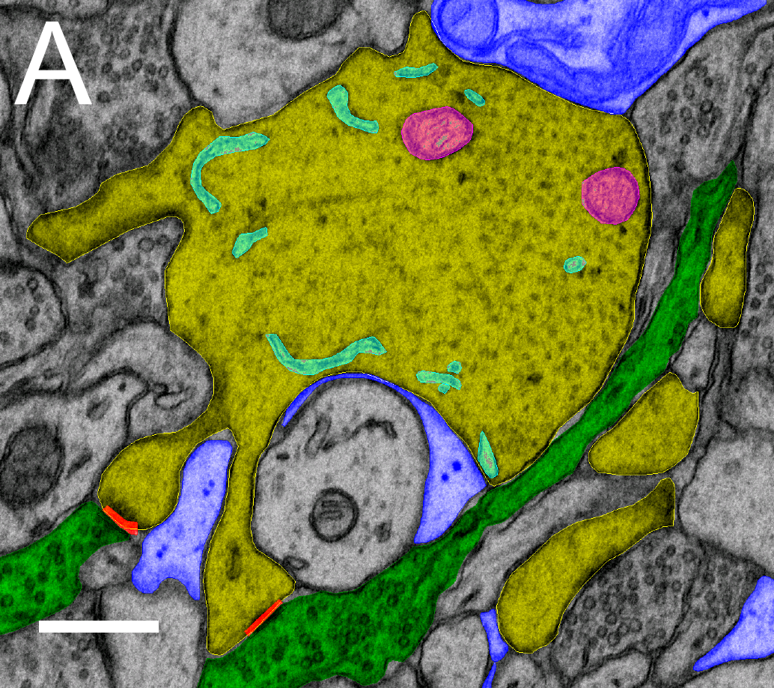
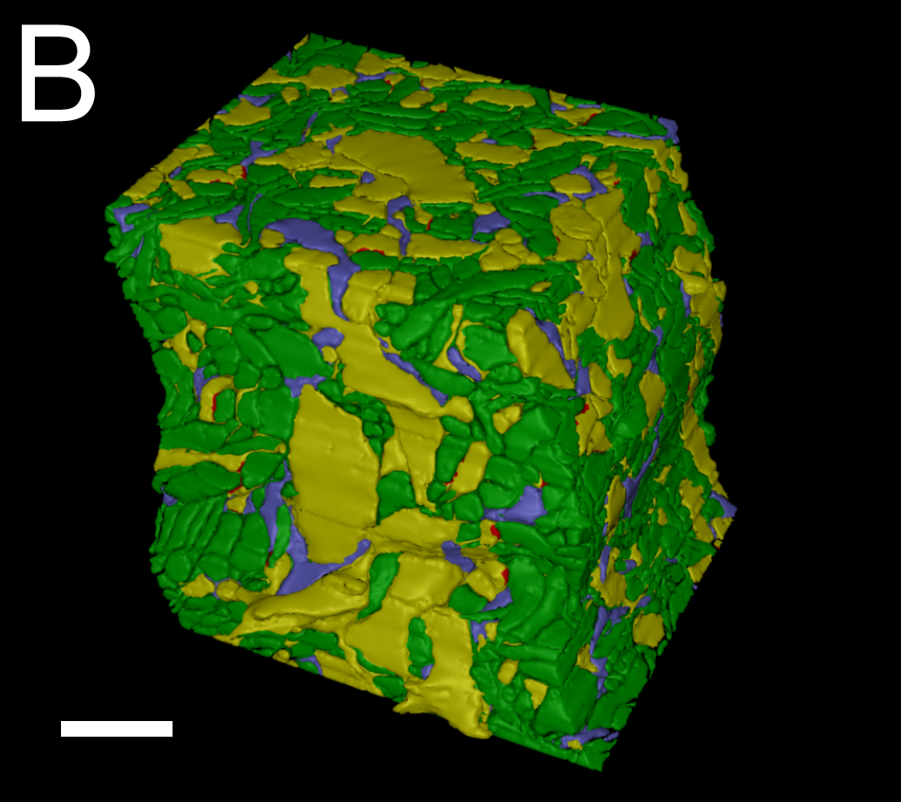
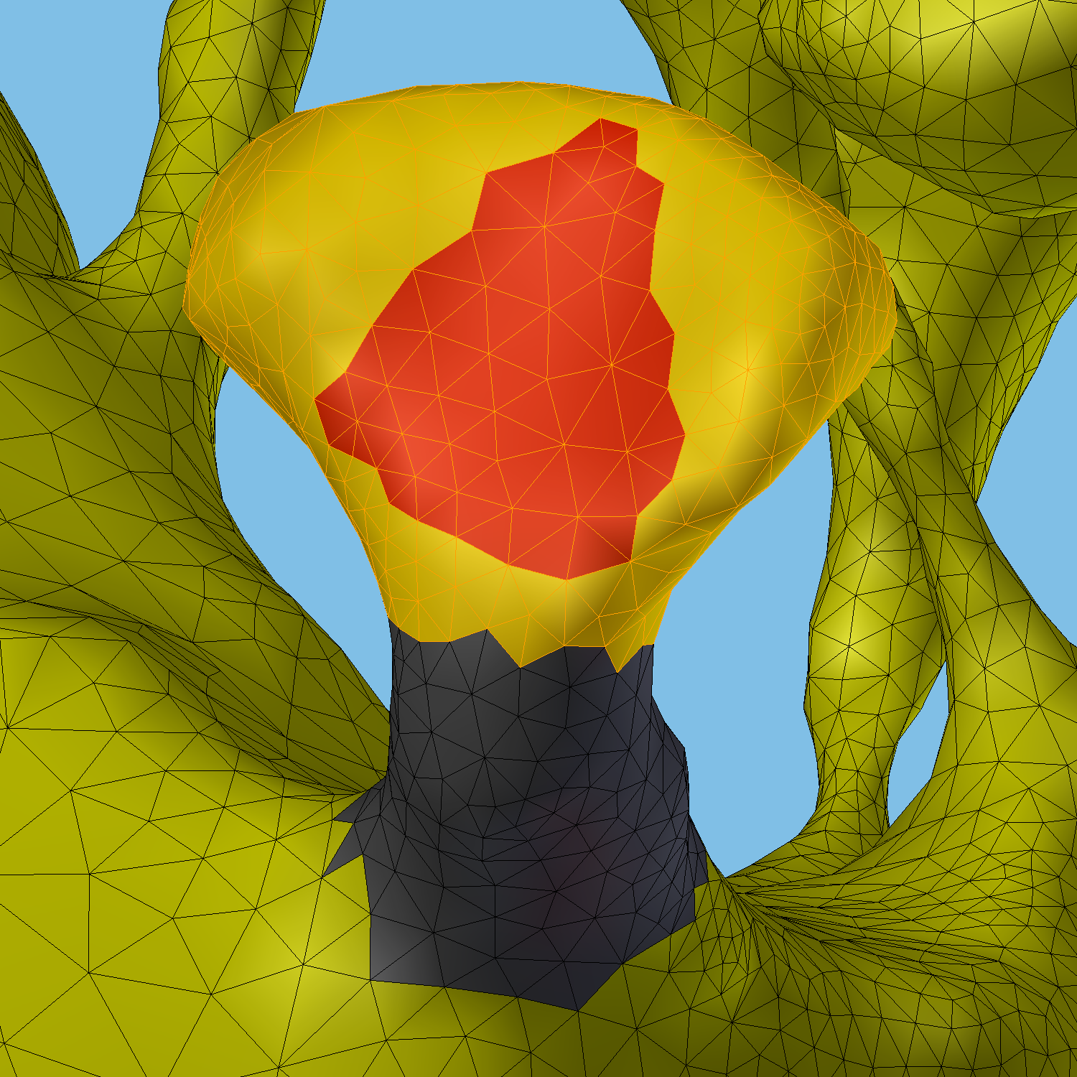
Nanoconnectomic upper bound on
the variability of synaptic plasticity
Dense Reconstruction
Analysis with
CellBlender/NeuropilTools

Slide 3
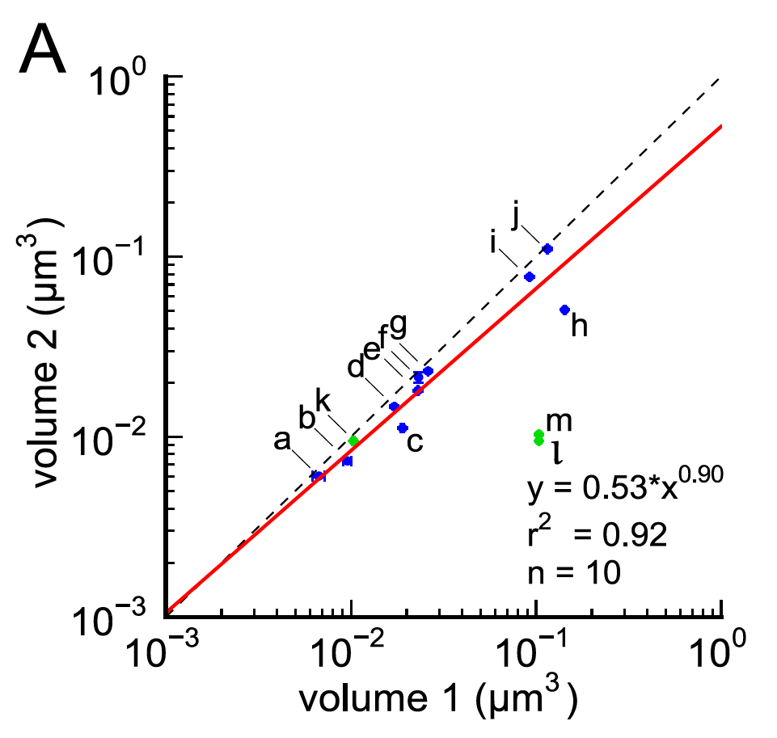
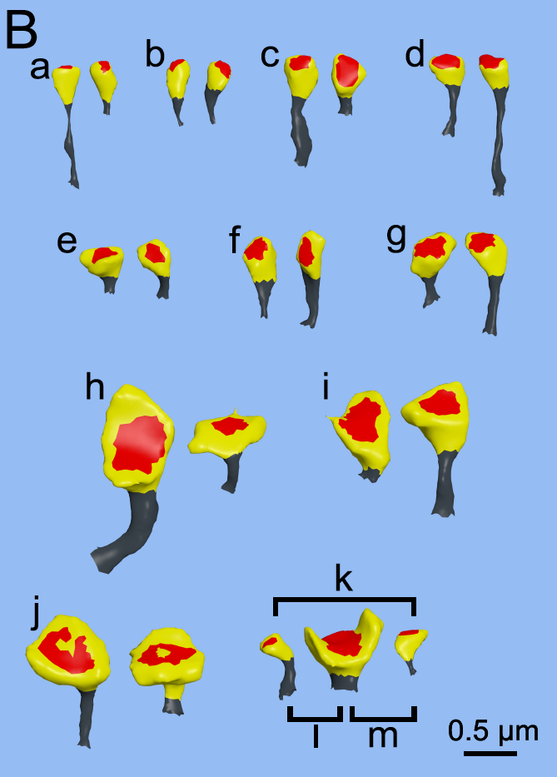
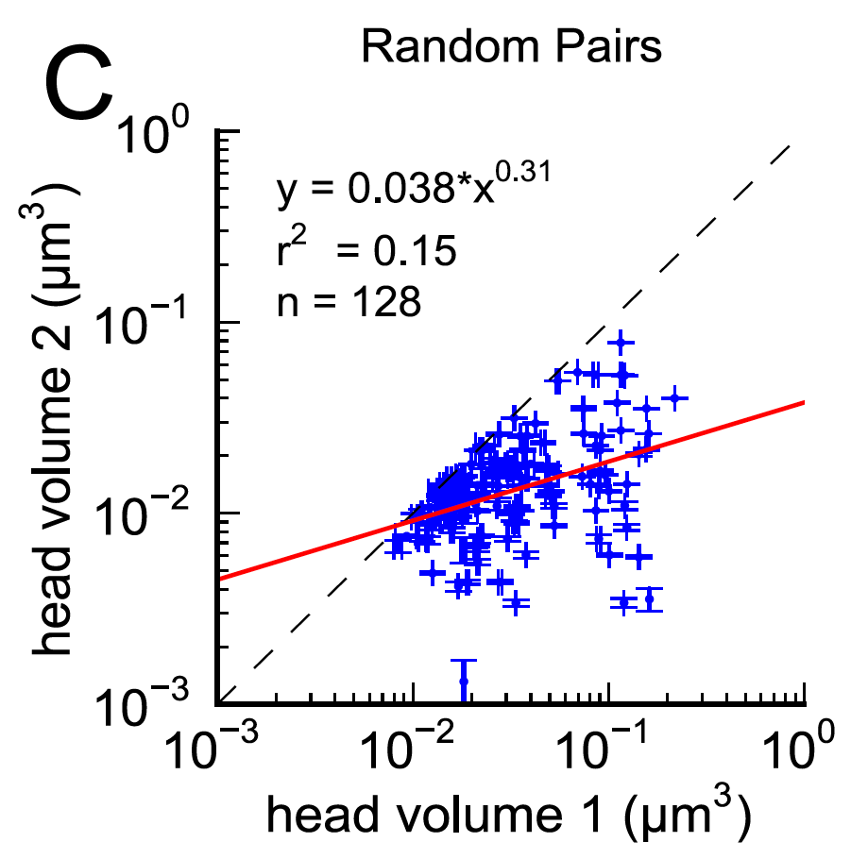
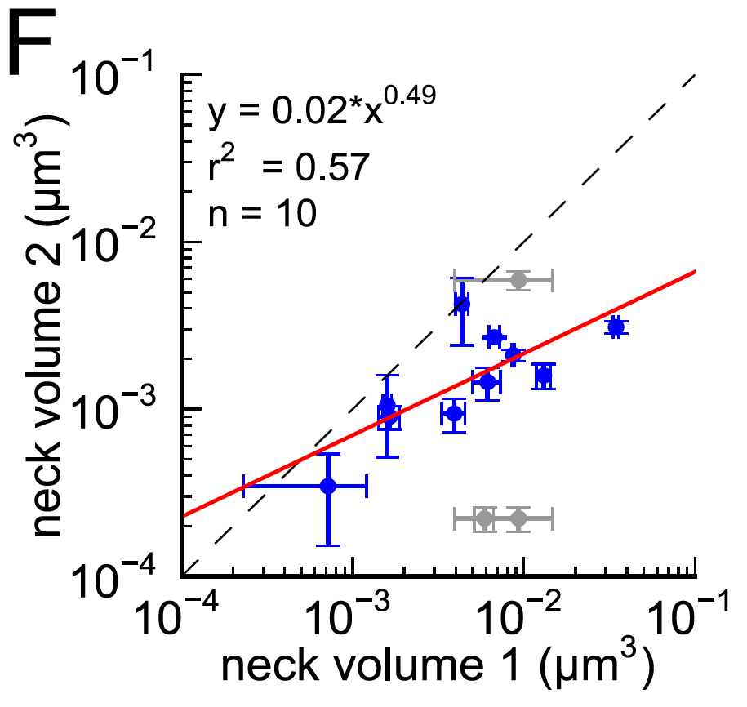

Slide 4
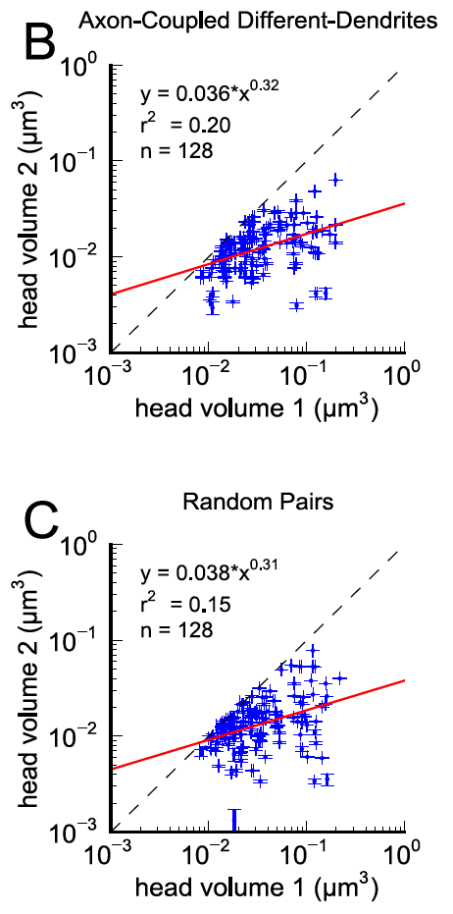
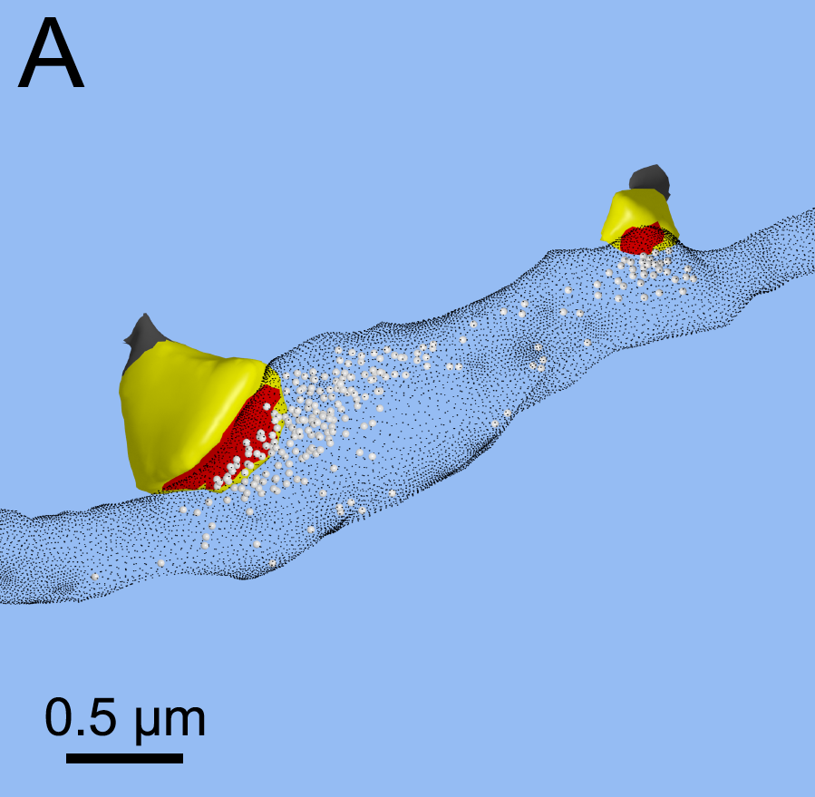

Slide 5
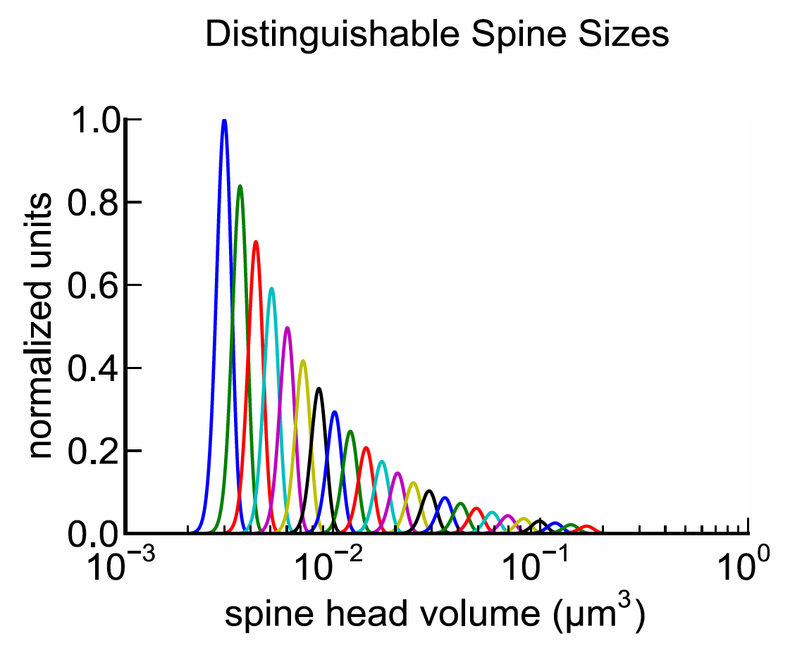
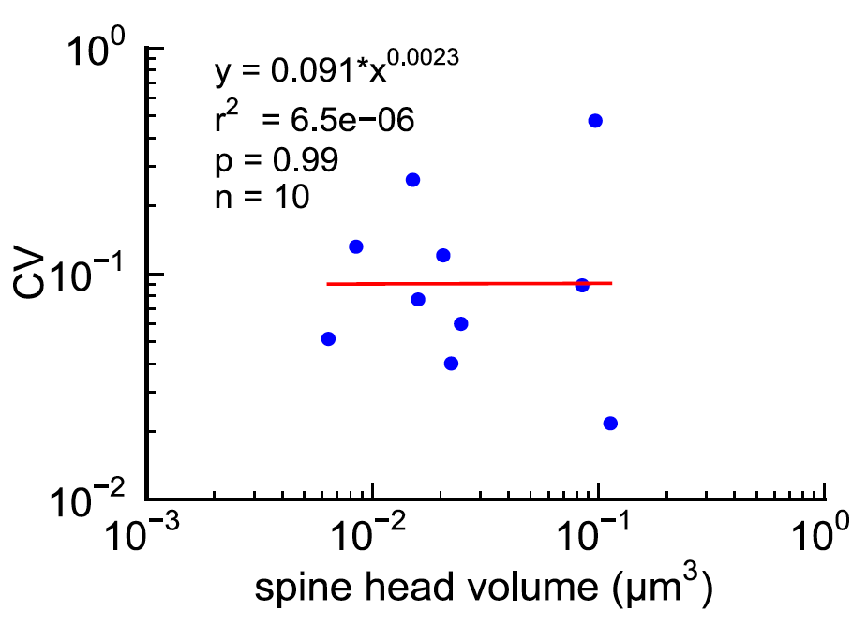
24 distinguishable sizes = 4.6 bits of precision

Slide 6
Time-window averaging could smooth fluctuations and explain precision
n = (1-pr)/(pr*CV²)

