Slide 1
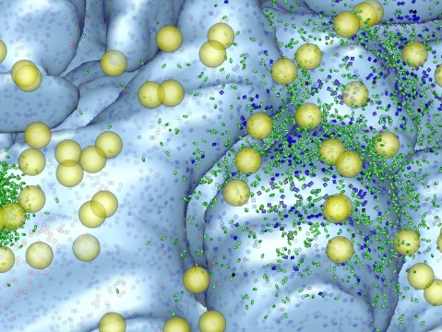
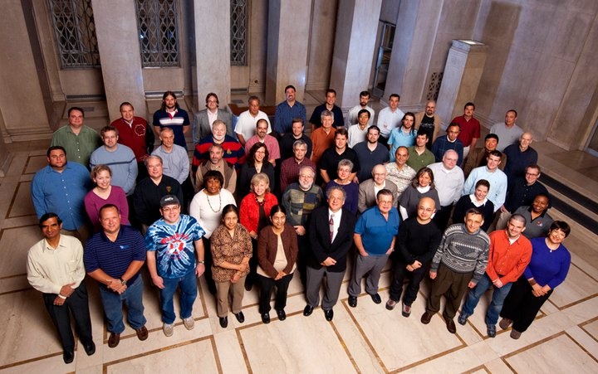
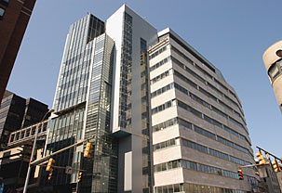
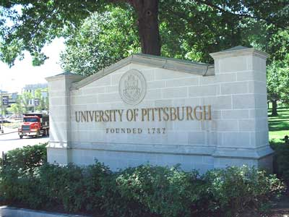
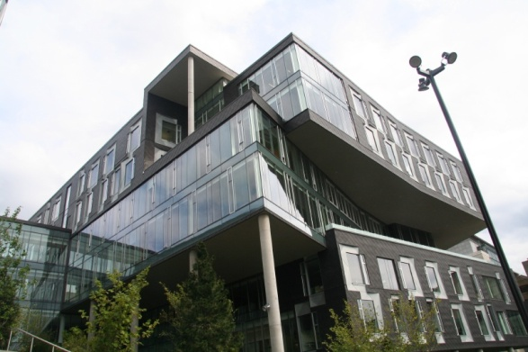
MMBioS
Biomedical Technology Research Resource (BTRC)
High Performance Computing
for
Multiscale Modeling of Biological Systems
Overarching biological theme:
Spatial organization
Temporal evolution
of (neuro)signaling systems/events
Salk
PSC
PITT
CMU

Slide 2
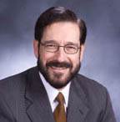
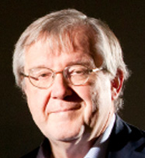
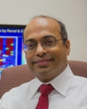
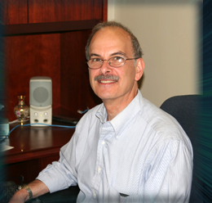
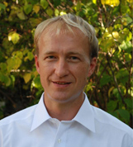
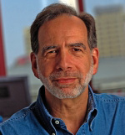
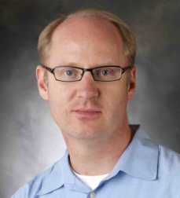
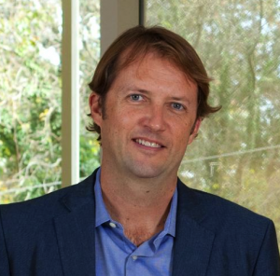
External Advisory Board Members
MMBioS
Harel Weinstein, DSc Maxwell M. Upson Professor of Physiology and Biophysics Chair, Dept of Physiology and Biophysics Director, Institute for Computational Biomedicine Weill Cornell Medical College of Cornell U Tri-Institutional Professor:WCMC, Rockefeller,MSKCC
Klaus Schulten,PhD Uof Illinois at Urbana-Champaign
Badrinath "Badri" Roysam, PhD Professor and Chair of Electrical and Computer Engineering University of Houston,
Martin Meier-Schellersheim, PhD Chief, Computational Biology Section, Laboratory of Systems Biology National Institute of Allergy and Infectious Diseases, NIH
Les Loew, PhD U of Connecticut Health Center
Ex-officio
Scott Acton, PhD Professor, Charles L. Brown Electrical and Computer Engineering Department, and
Department of Biomedical Engineering Director, Virginia Image and Video Analysis Lab University of Virginia
Peter Strick, PhD Distinguished Professor Chair of Neurobiology
U of Pittsburgh, SOM
Nathan Urban, PhD Prof of Neurobiology CNBC Co-Director
Pitt, SOM

Slide 3
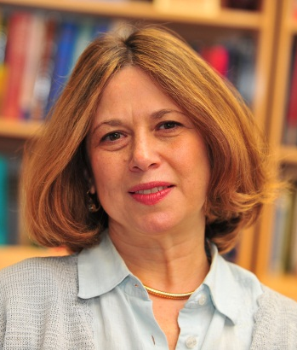
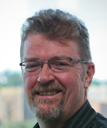
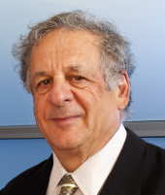
MMBioS
BTRC Administration
PSC Leadership
(Ralph Roskies)
Salk Leadership
(Terry Sejnowski)
CMU Leadership
(Robert Murphy)
PSC System Administration
PI (Pitt)
Ivet Bahar
Pitt DCSB Financial Administration
(Marcia Schwab)
Ivet Bahar, PhD: John K. Vries Chair and Founder of the Dept of Computational & Systems Biology (CSB), School of Medicine (SOM), U of Pittsburgh (Pitt); co-Founder (with R.F. Murphy) of the Joint PhD Program between Pitt and CMU; Associate Director of the University of Pittsburgh Drug Discovery Institute (UPDDI)
Terry J. Sejnowski, PhD: Francis Crick Professor and Director of the Computational Neurobiology Laboratory at the Salk Institute for Biological Sciences (Salk), Distinguished Professor at UCSD Dept of Neurobiology/ Neurosciences; an investigator with the Howard Hughes Institute and a member of the NAS.
Robert F. Murphy, PhD: Ray and Stephanie Lane Professor and Head of Computational Biology at Carnegie Mellon University; Professor of Biological Sciences, Bioengineering and Machine Learning; co-founder of Joint PhD Program in Comp Bio between Pitt and CMU
Ralph Roskies, PhD: Co-Founder (with M. Levine, CMU) and Scientific Director of the Pittsburgh Supercomputing Center (PSC); Professor of Physics, School of Arts & Sciences, Pitt; PI of the P41 National Resource for Biomedical Supercomputing (NRBSC) between 1990 and 2005; Appointed to National Library of Medicine (NIH) Board of Regents in 2011.

Slide 4
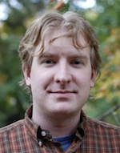
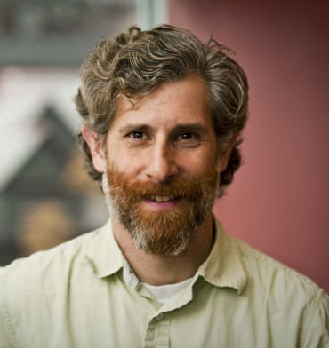
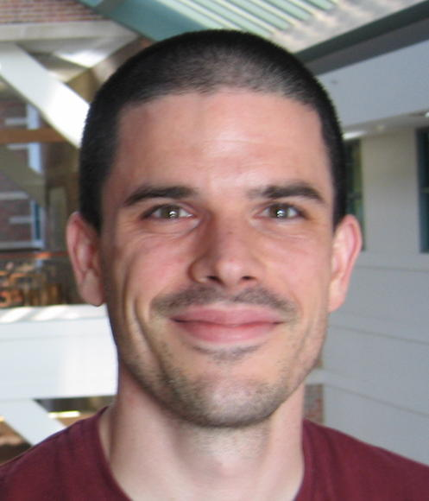
MMBioS
BTRC Administration
PSC Leadership
(Ralph Roskies)
Salk Leadership
(Terry Sejnowski)
CMU Leadership
(Robert Murphy)
PSC System Administration
PI (Pitt)
Ivet Bahar
Pitt DCSB Financial Administration
(Marcia Schwab)
Executive Committee (EC)
Carl Kingsford, PhD
Associate Prof, Dept of Computational Biology;
Carnegie Mellon U; specialized in chromatin structure and assembly, and protein interaction networks.
TR&D1
(Bahar Zuckerman)
TR&D2
(Faeder & Sejnowski)
TR&D3
(Murphy)
Training
(Dittrich)
Dissemination
(Dittrich)
Dan M. Zuckerman PhD, Assoc Prof at Comp & Sys Biol Dept (CSB), Pitt, Director of CMU/ Pitt Joint PhD Program in Comput Biology; expert in molecular modeling & simulations
James R. Faeder, PhD: Assoc Professor at the CSB, expert in rule-based modeling of biochemical networks and signal transduction events, co-developer of cell mode ling software BioNetGen
Markus Dittrich, PhD: Senior Scientist at the PSC; knowledge on both molecular (MD) and cellular (MCell) simulations; leader of he Natl Res for Biomed Supercomp (NRBSC) at the PSC; Director of PSC Educational activities

Slide 5
MMBioS
External Advisory Board (EAB)
BTRC Administration
PSC Leadership
(Ralph Roskies)
Salk Leadership
(Terry Sejnowski)
CMU Leadership
(Robert Murphy)
PSC System Administration
PI (Pitt)
Ivet Bahar
Pitt DCSB Financial Administration
(Marcia Schwab)
Executive Committee (EC)
TR&D1
(Bahar)
TR&D2
(Faeder & Sejnowski)
TR&D3
(Murphy)
Training
(Dittrich)
Dissemination
(Dittrich)
DBP1
(Amara & Torres)
DBP2
(Kennedy)
DBP3
(Sorkin)
DBP4
(Wuelfing)
DBP5
(Reid)

Slide 6
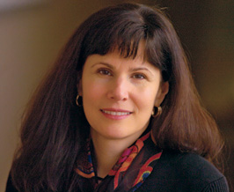
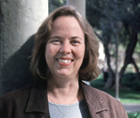
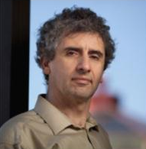
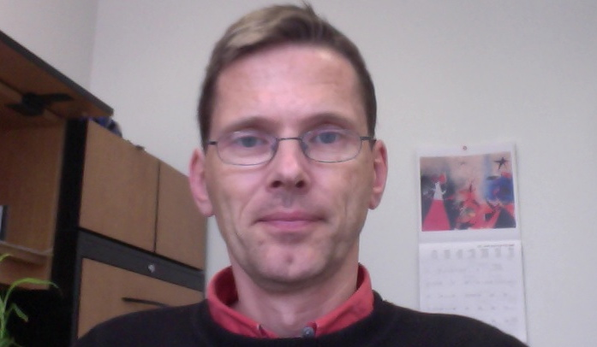
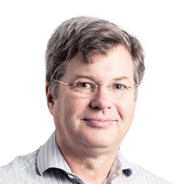
MMBioS
External Advisory Board (EAB)
BTRC Administration
PSC Leadership
(Ralph Roskies)
Salk Leadership
(Terry Sejnowski)
CMU Leadership
(Robert Murphy)
PSC System Administration
PI (Pitt)
Ivet Bahar
Pitt DCSB Financial Administration
(Marcia Schwab)
Executive Committee (EC)
DBP2
(Kennedy)
DBP4
(Wuelfing)
DBP5
(Reid)
Driving Biomedical Projects Leaders
TR&D1
(Bahar)
TR&D2
(Faeder & Sejnowski)
TR&D3
(Murphy)
Training
(Dittrich)
DBP1
(Amara & Torres)
DBP2
(Kennedy)
Susan G. Amara, PhD
Scientific Director, National Institute of Mental Health, NIH
Mary B. Kennedy, PhD
The Allen and Lenabelle Davis Professor of Biology,
Caltech
Alexander (Sasha) Sorkin, PhD, Professor and Richard Beatty Mellon Chair, Dept of Cell Biology & Physiology, Pitt
Christoph Wuelfing, PhD
Professor, School of Cellular and Molecular Medicine
University of Bristol, UK
R. Clay Reid, MD, PhD
Senior Investigator,
Neural Coding,
Allen Institute for Brain Science, Seattle
DBP3
(Sorkin)
DBP4
(Wuelfing)
DBP5
(Reid)

Slide 7
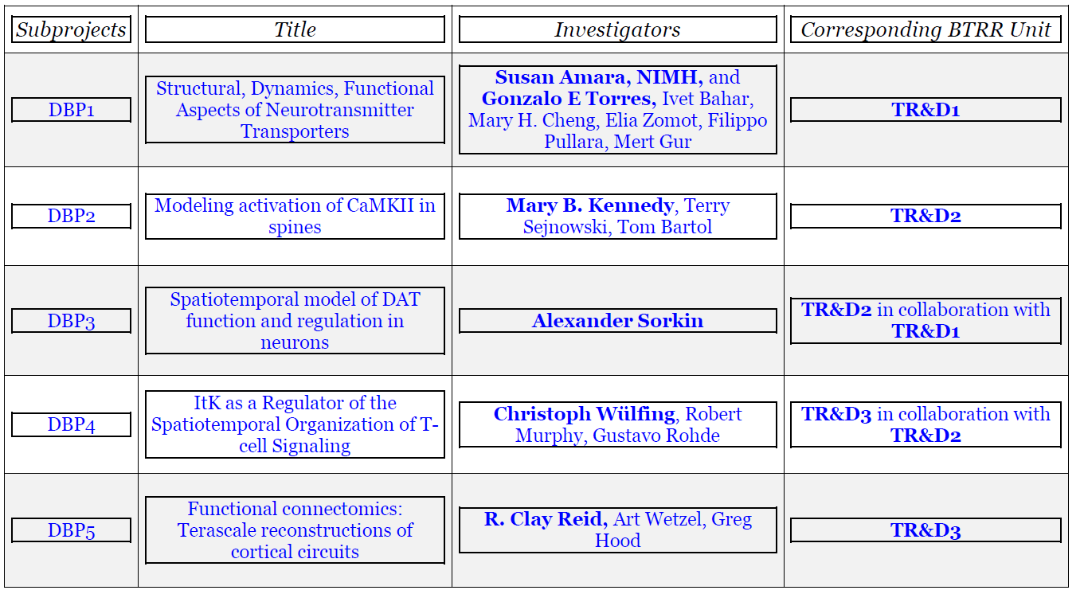
DBPs
MMBioS

Slide 8
MMBioS
External Advisory Board (EAB)
BTRC Administration
PSC Leadership
(Ralph Roskies)
Salk Leadership
(Terry Sejnowski)
CMU Leadership
(Robert Murphy)
PSC System Administration
PI (Pitt)
Ivet Bahar
Pitt DCSB Financial Administration
(Marcia Schwab)
Executive Committee (EC)
TR&D1
(Bahar)
TR&D2
(Faeder & Sejnowski)
TR&D3
(Murphy)
Training
(Dittrich)
Dissemination
(Dittrich)
DBP1
(Amara & Torres)
Training & Dissemination Activities
C&S7
DBP5
(Reid)
C&S4
C&S6
C&S19
C&S1
C&S2
C&S16
C&S5
C&S8
C&S10
C&S11
C&S12
DBP3
(Sorkin)
DBP4
(Wuelfing)
C&S17
C&S18
DBP2
(Kennedy)
C&S13
C&S14
C&S15

Slide 9
C&SPs
MMBioS
Subprojects | Title |  |  |  |  |  | Investigators |  |  |  |  |  | Corresponding BTRR Unit
C&SP1 | Relationship between structural dynamics and Sequence Evolution; Application to molecular machines such as bacterial chaperonins and HSP70 chaperones |  |  |  |  |  | Amnon Horovitz, Lila Gierasch, Russ Altman, Mandy Blackburn, I. General, Ivet Bahar, Cihan Kaya |  |  |  |  | TR&D1
C&SP2 | AMPA and NMDA receptors structural dynamics |  |  |  |  |  | Ingo Greger, James Kreiger, Ivet Bahar, Jiyoung Lee,Anindita Dutta, Indira Shrivastava |  |  |  |  | TR&D1
C&SP4 | Calcium Entry and Transmitter Release at the Neuromuscular Junction |  |  |  |  |  | Stephen D. Meriney, Markus Dittrich |  |  |  |  | TR&D2
C&SP5 | Modeling the dynamic FcεRI membrane landscape for signaling and endocytosis |  |  |  |  |  | James Faeder, William Hlavacek, Bridget Wilson |  |  |  |  | TR&D2
C&SP6 |  | Distance-dependent structure and function of neuronal dendrites |  |  |  |  |  |  | Kristin Harris, Terrence Sejnowski, Tom Bartol |  |  | TR&D2l
C&SP7 | Interfacing Image-derived Generative Models with Cell Simulation Engines |  |  |  |  |  | Michael Hucka, Steve Andrews, Ion Moraru,James Schaff, Les Loew, Roger Brent, Markus Dittrich, Gustavo K. Rohde, Robert F. Murphy |  |  |  |  | TR&D3
C&SP8 | Using generative models of cell organization to investigate tumor cell heterogeneity |  |  |  |  |  | Steven Altschuler, Lani Wu, Robert F. Murphy, Gustavo K. Rohde |  |  |  |  | TR&D3
C&SP10 | High-throughput scanning EM for neural structure |  |  |  |  |  | Jeff Lichtman, Josh Morgan, Art Wetzel |  |  |  |  | TR&D3
C&SP11 | Morphological and regulatory models of neuronal differentiation |  |  |  |  |  | Hauke Busch, Melanie Boerries, Robert F. Murphy, Gustavo K. Rohde |  |  |  |  | TR&D3
C&SP12 | Generative models of plant organelle distribution and differentiation |  |  |  |  |  | Klaus Palme, Robert F. Murphy |  |  |  |  | TR&D3
C&SP13 | Microtubule pattern analysis and drug sensitivity |  |  |  |  |  | Paraskevi Giannakakou, Robert F.Murphy |  |  |  |  | TR&D3
C&SP14 | Actin filament patterns and cell motility |  |  |  |  |  | Julie Theriot, Gustavo K. Rohde, Dejan Slepcev |  |  |  |  | TR&D3
C&SP15 | Reconstructing zebrafish neural circuits controlling visually induced behaviors |  |  |  |  |  | Florian Engert, David Hildebrand, Art Wetzel |  |  |  |  | TR&D3
C&SP16 | Latent Factor Models for Identification of Novel Neuroprotectives for Huntington’s Disease |  |  |  |  |  |  |  | Robert Friedlander, Mark Schurdak, Andrew Stern, Lans Taylor, Diane Carlisle, Ivet Bahar, Bing Liu |  |  | TR&D1
C&SP17 |  |  | Structure and Function of Voltage-Gated Calcium Channels |  |  |  |  |  | Peter Wipf, Stephen Meriney, Ivet Bahar, Mary H. Cheng |  |  | TR&D1
C&SP18 | Regulating synaptic transmission by ADAR- |  |  |  |  |  | Dr. QingDe Wang (PI, UPMC), Ivet Bahar, Mary H Cheng |  |  |  |  | TR&D1
C&SP19 |  |  | Modeling Dendritic Sparks at Dendritic Branch Points |  |  |  |  | M.H. Ellisman (PI; UCSD), TJ. Sejnowski, TM. Bartol |  |  |  | TR&D2

Slide 10
Accomplishments by numbers
64 NCBI-listed papers published in 2013-2015, which acknowledged the MMBioS BTRR (+ 4 accepted, in press).
ProDy software downloaded ~ 86,334 times, and MCell/Cell Blender/Cell Organizer more than 10,000 times, in May 2014 - May 2015
22 active subprojects (5 DBP + 17 C&SP)

Slide 11
PSC
Carnegie Mellon U
U of Pittsburgh

